Slide 1

Task 1
Exploratory Data Analysis
Prepared by priya more
2 July 2020

Slide 2
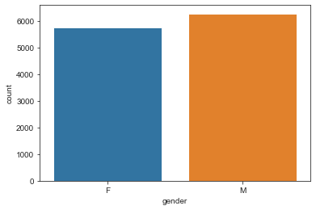
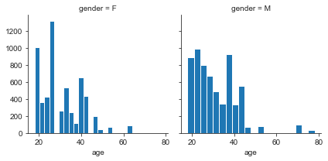
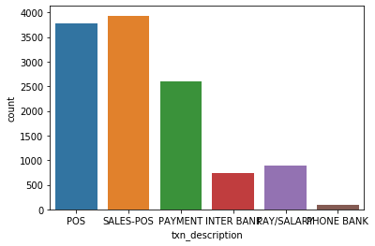
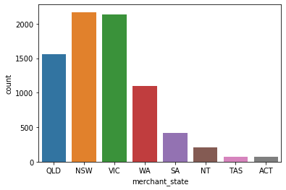
Gender Ratio
Age Distribution
Average Age
31
Transaction Type
Merchant state
Average amount of transaction
187.933

Slide 3
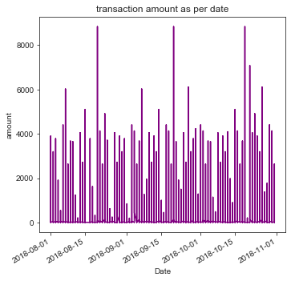
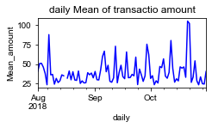
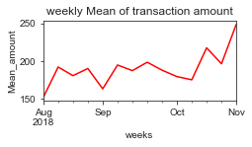
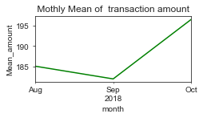
Transaction as per date (Daily, Monthly, Weekly)

Slide 4
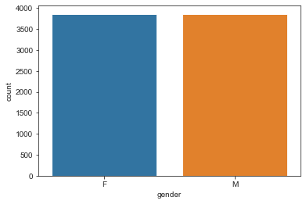
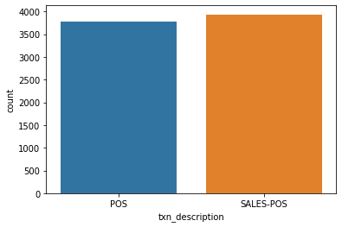
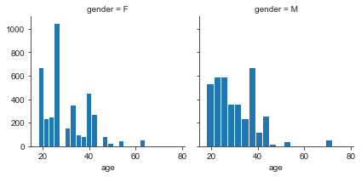
Authorized Transaction
Transaction Type
Gender ratio
Transaction as per age and gender
Max balance of authorized transaction
267093.66
Average amount authorized transaction
40

Slide 5
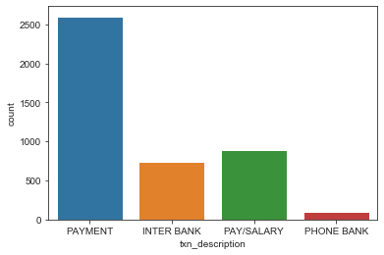
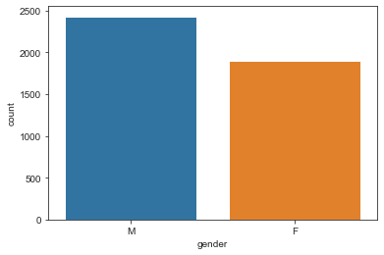
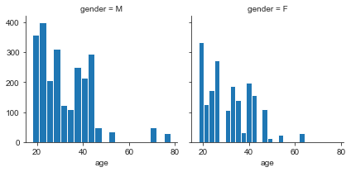
Posted Transaction
Transaction Type
Gender ratio
Transaction as per age and gender
Max balance of Posted transaction
267128.52
Average amount Posted transaction
451.5529

Slide 6
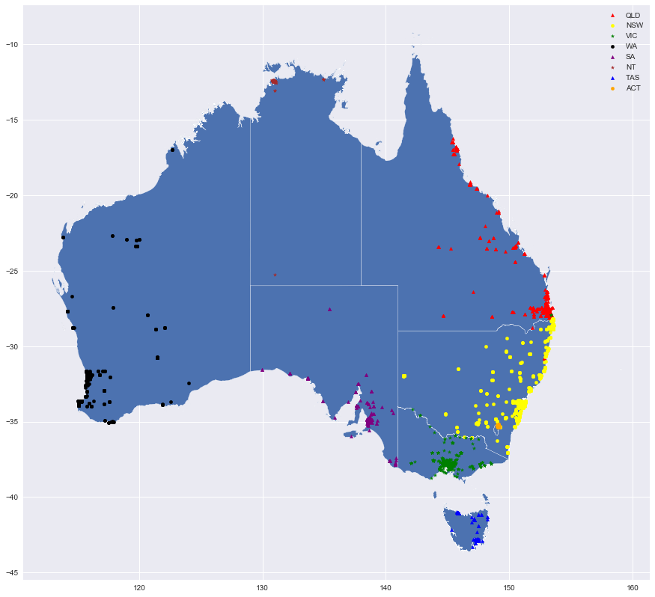
Point plot on Australia map from the location information provided in the dataset
From this map we can visualize that more transactions are made in NSW,QLD and VIC.

